Slide 1
Accident Trends
In London
By Tim Barry, Brooke Rodriguez, Fiona Weston, & Bailey Passmore

Slide 2
When are accidents more likely to happen?
What time of day?
What day of the week?
What month in the year?

Slide 3
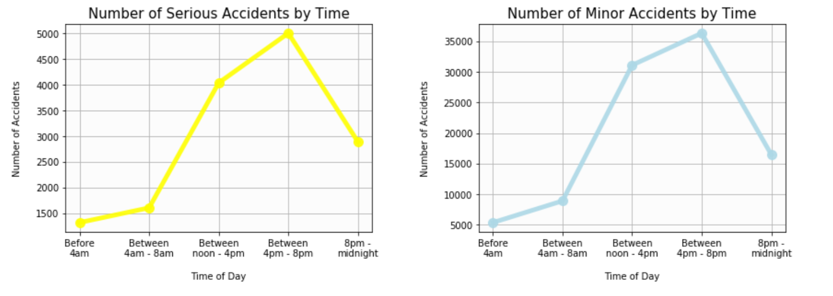
Are there more accidents during rush hour?
Peaks around 4pm - 8pm with
5,009 Serious accidents
Peaks around 4pm - 8pm with
36,311 Minor accidents

Slide 4
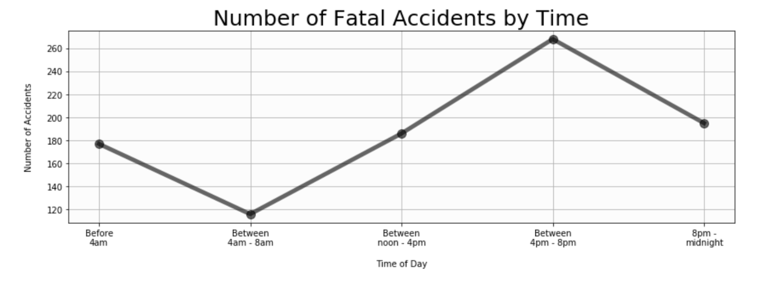
Are there more accidents during rush hour?
Peaks between 4pm - 8pm with
268 Fatal accidents

Slide 5
Are weekdays more likely to have accidents?

Slide 6
Is there a greater number of accidents in Summer?

Slide 7
In general, there are increases in the number of accidents in London between _______, on _______, and in ______

Slide 8
Do weather conditions affect the number of accidents?
Is it really worse when raining?
What day of the week?
What month in the year?

Slide 9
Are there more accidents during rush hour?

Slide 10
Are weekdays more likely to have accidents?

Slide 11
Is there a greater number of accidents in Summer?

Slide 12
Is better lighting effective in decreasing accidents?
What time of day?
What day of the week?
What month in the year?

Slide 13
Are there more accidents during rush hour?

Slide 14
Are weekdays more likely to have accidents?

Slide 15
Is there a greater number of accidents in Summer?

Slide 16
Do road conditions play a role in likeliness of an accident?
What time of day?
What day of the week?
What month in the year?

Slide 17
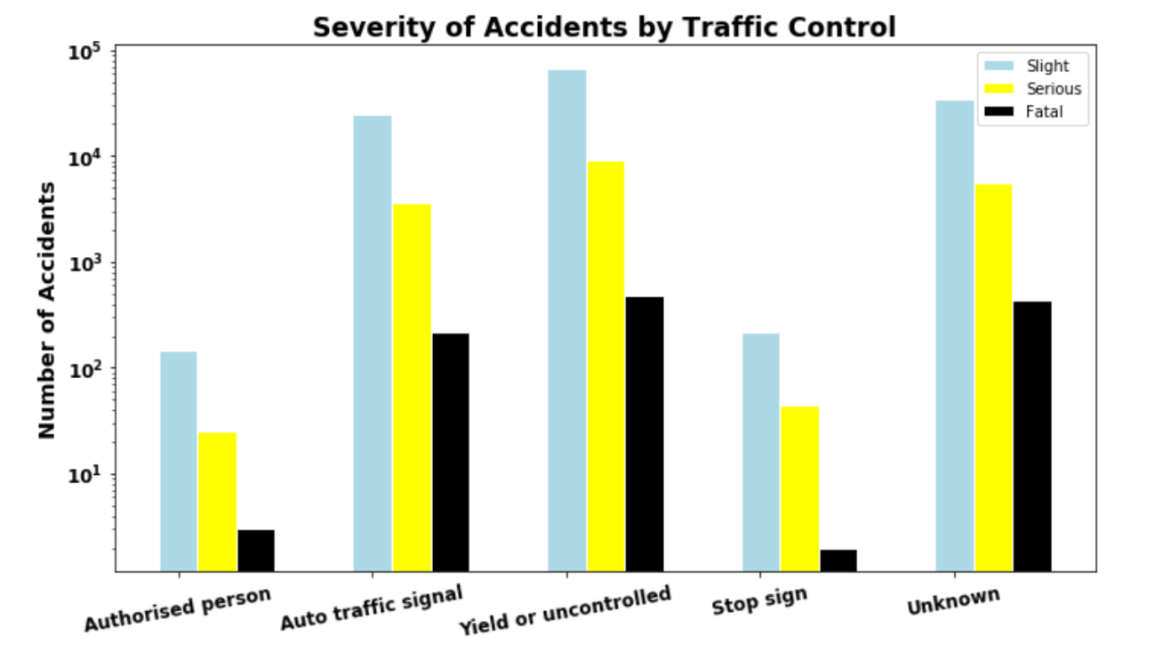
Does traffic control lower the number of accidents?
Stop signs or a traffic control person were present for just
0.39% of Fatal or Serious accidents
Stop signs or a traffic control person were present for just
0.39% of Fatal or Serious accidents

Slide 18
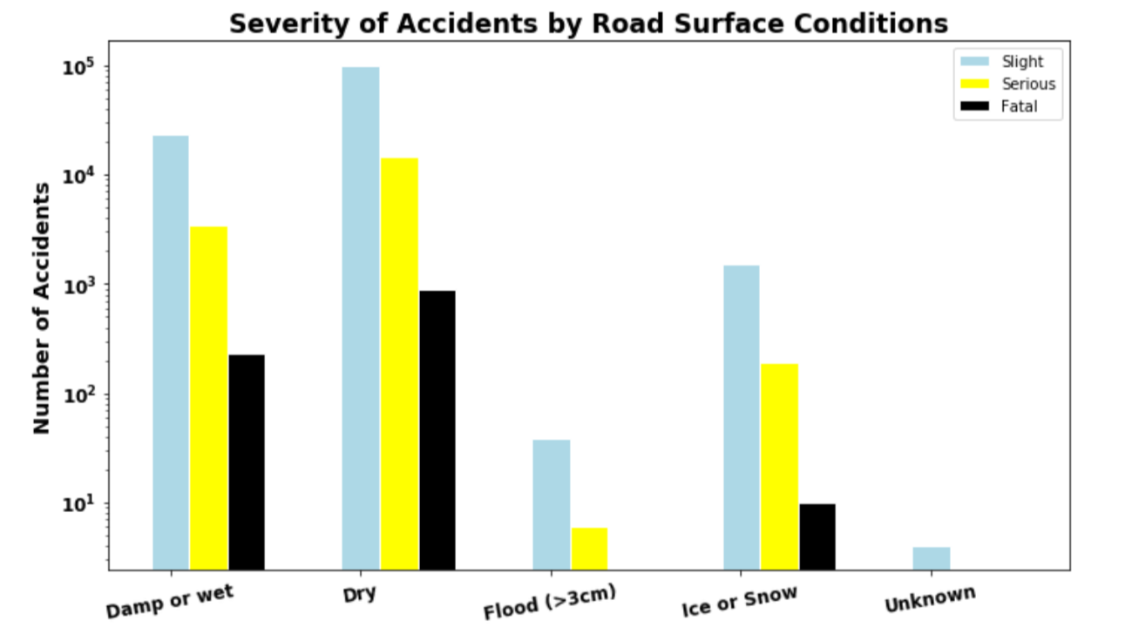
Is rain associated with more accidents?
Dry weather alone accounts for
80.2% of Serious or Fatal accidents
Damp or wet roads make up only
18.8% of Serious or Fatal accidents

Slide 19
Yield/Uncontrolled is the most dangerous Traffic control method with the highest number of all levels of accidents.
Stop signs and a traffic control person are both highly effective at preventing fatal accidents (<10) each over 5 years of data.

